Slide 1
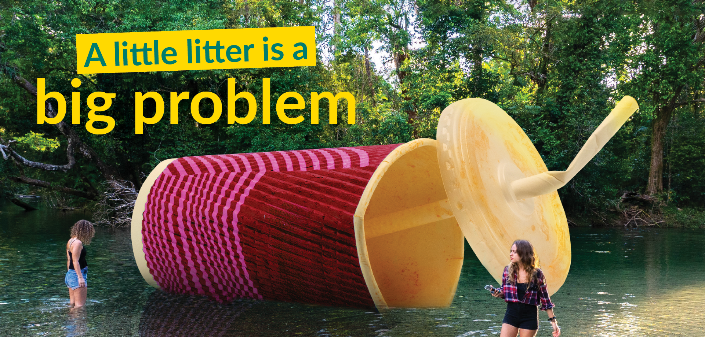



Slide 2

Bin it
don’t kill it
Did you know
Litter travels from land to our Great Barrier Reef through stormwater run-off?
While some may believe an innocent chip packet or cigarette won’t cause any harm. The truth is, 100,000 marine mammals dire every year around the world, due to plastic pollution.

Slide 3
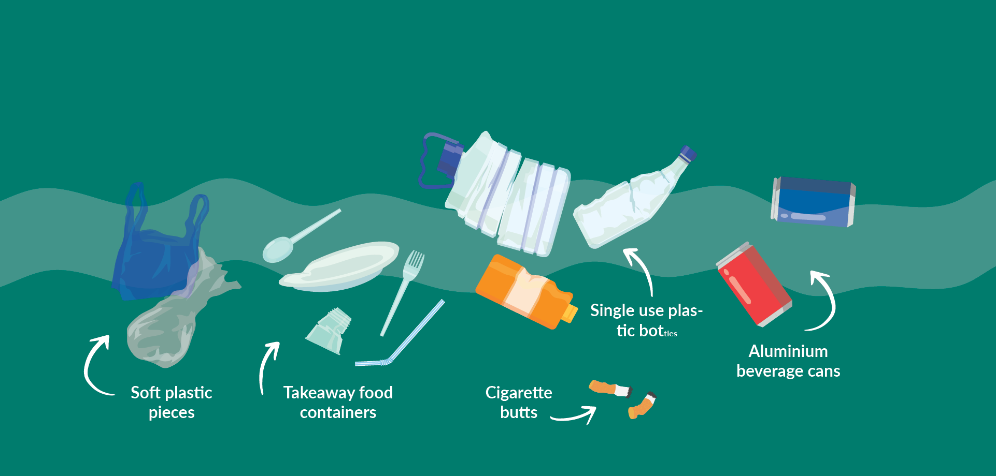
Everyday litter items we find include:

Slide 4




The damage it causes
Plastic has been eaten or entangled by:
65%
95%
33%
56%
All marine species
Seabirds
Turtles
Whales and dolphins

Slide 5

Care for land and sea –
put your rubbish in the bin

